Slide 1
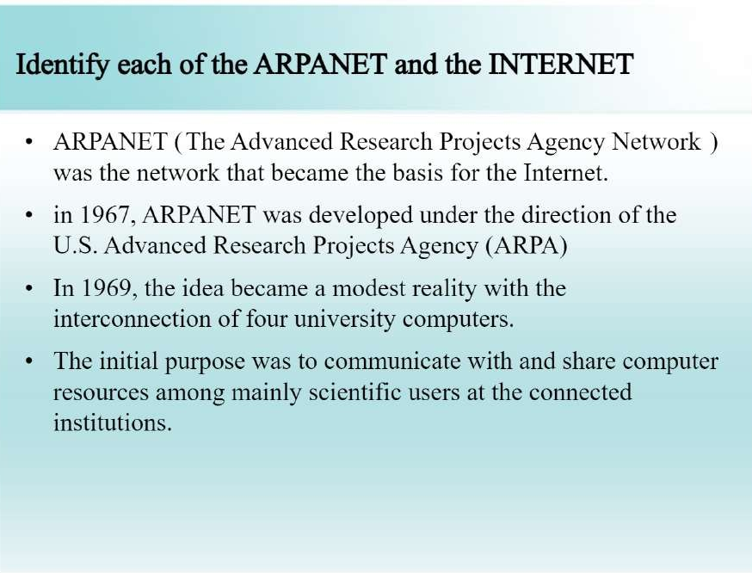

Slide 2
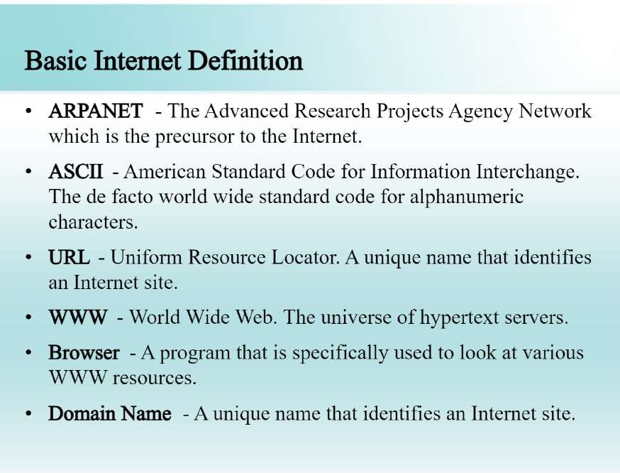

Slide 3
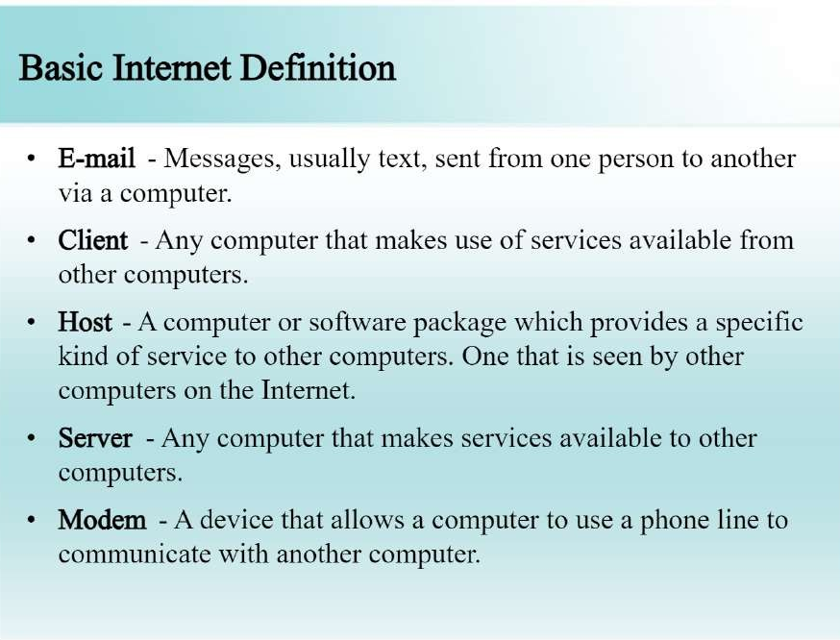

Slide 4
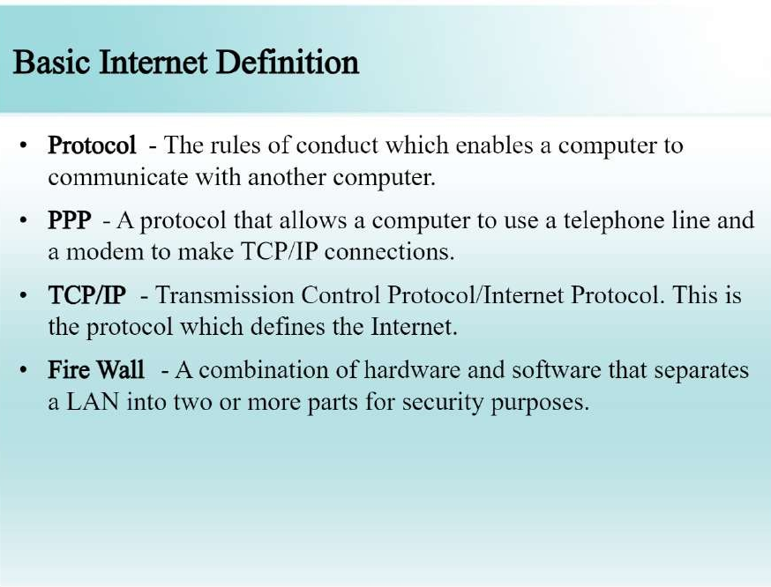

Slide 5
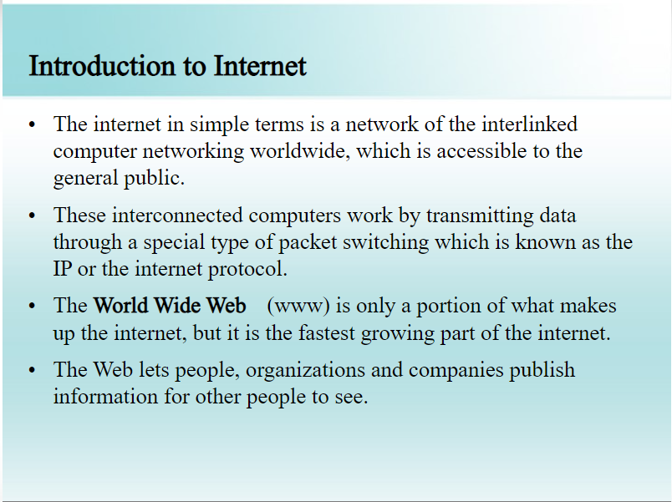
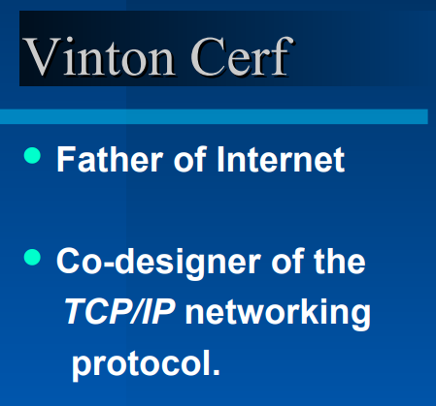

Slide 6
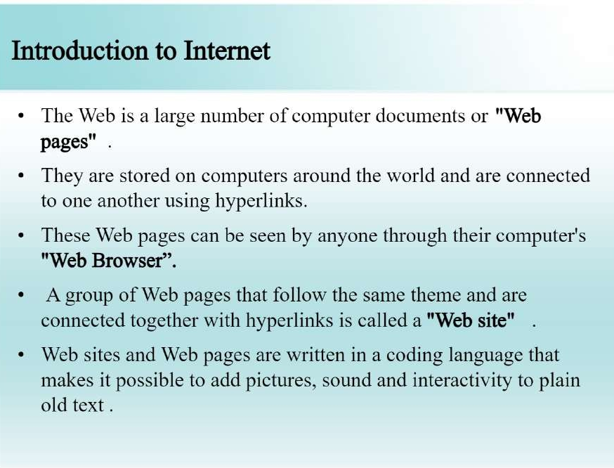

Slide 7
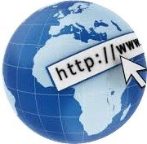
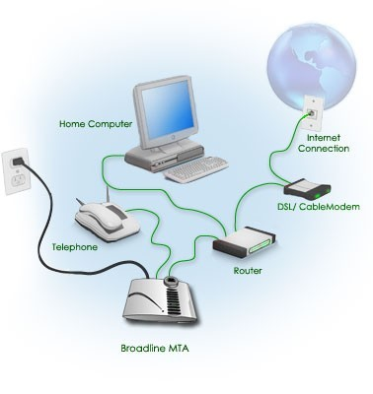
Connect to Internet

Slide 8
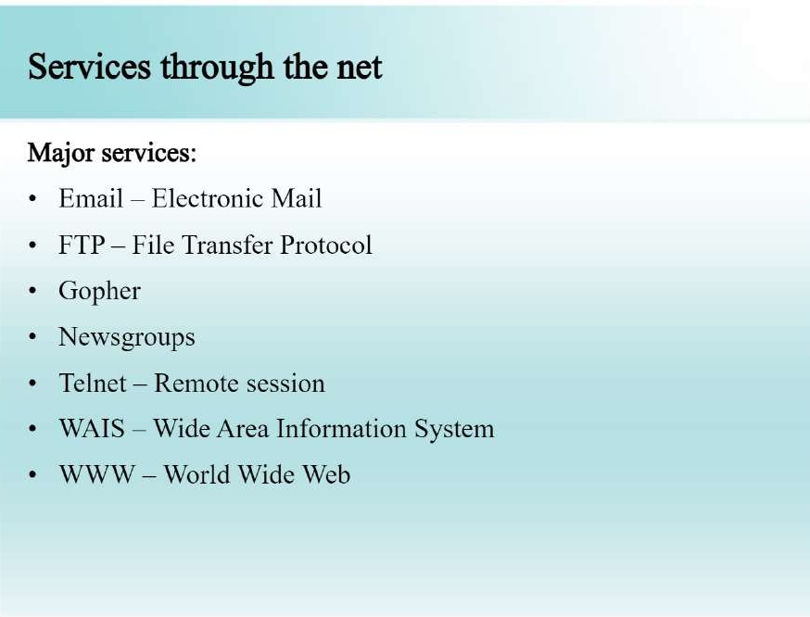
Webpage / Homepage
Web Publishing
Web browser
Search Engine
Protocol
Internet protocol
DNS
HTTP
URL
HTML
ISP
Newsgroup
Video conferencing
Forum

Slide 9
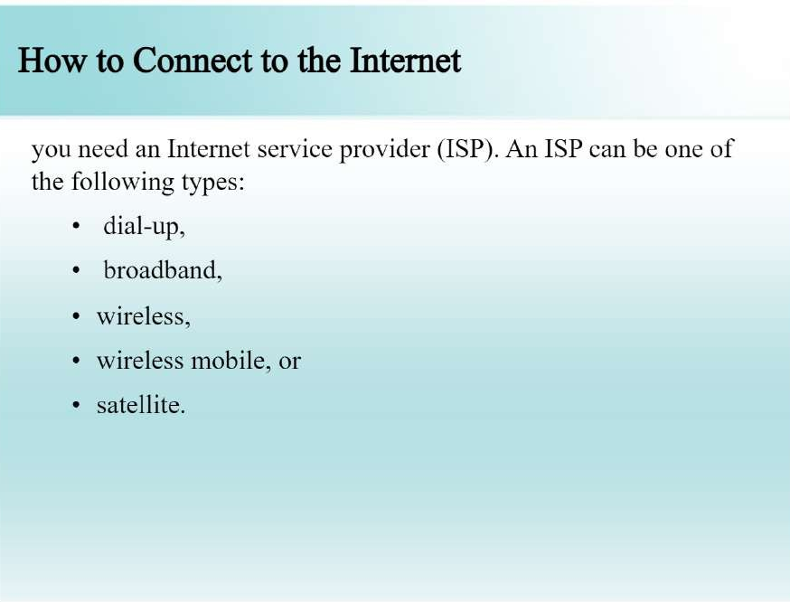

Slide 10
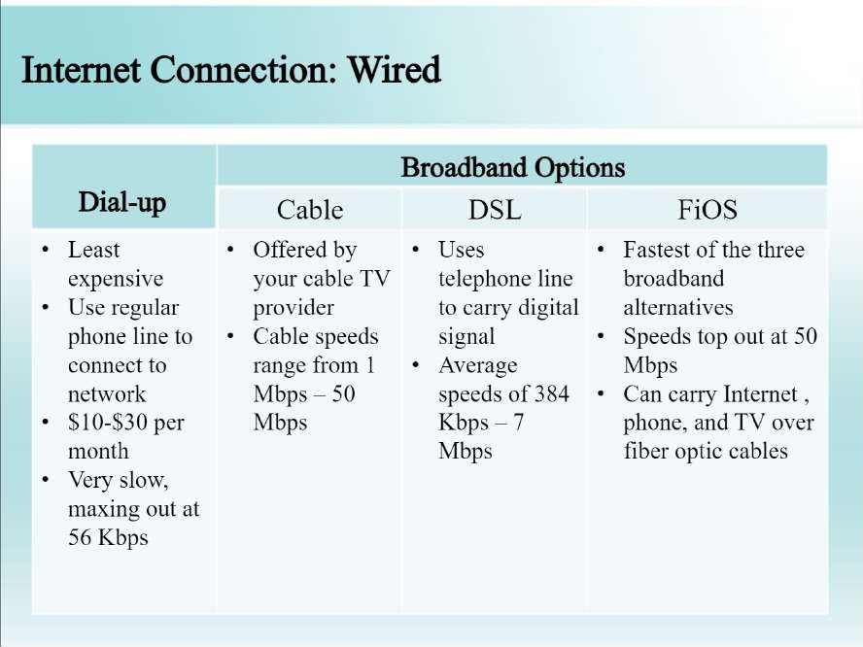

Slide 11
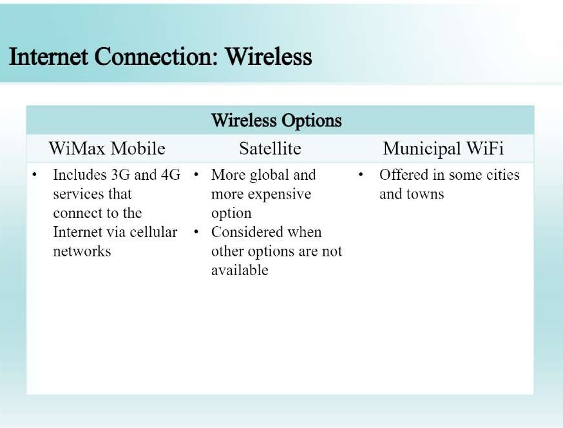

Slide 12
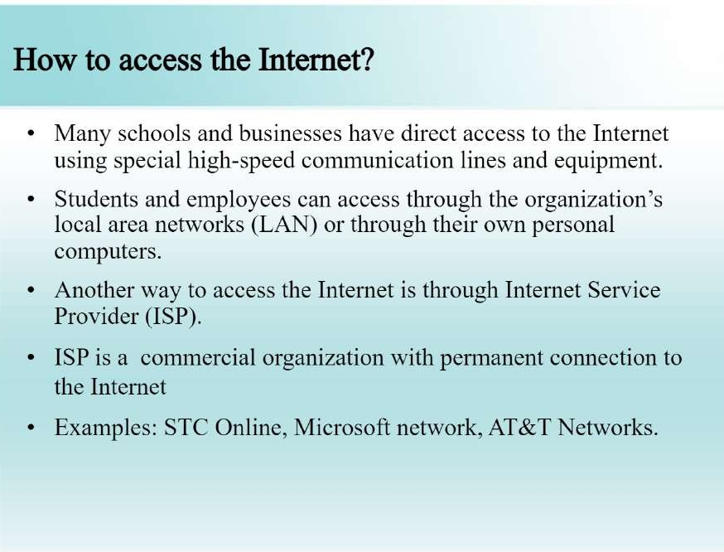

Slide 13
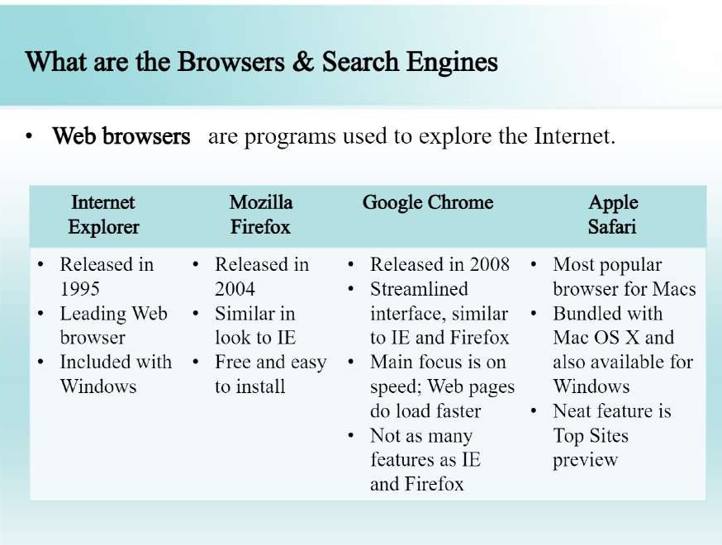

Slide 14
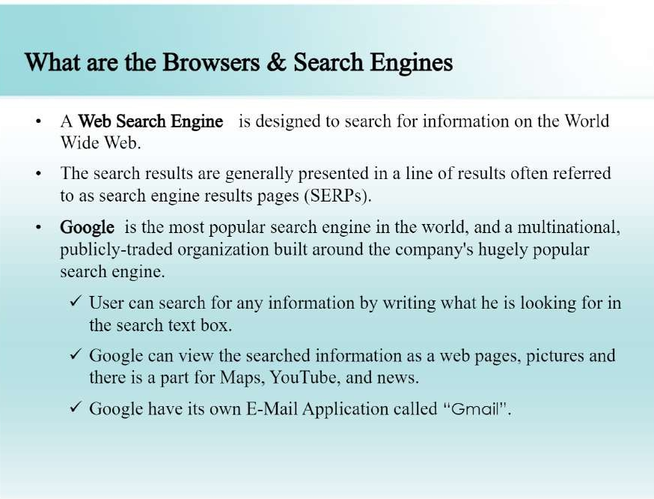

Slide 15
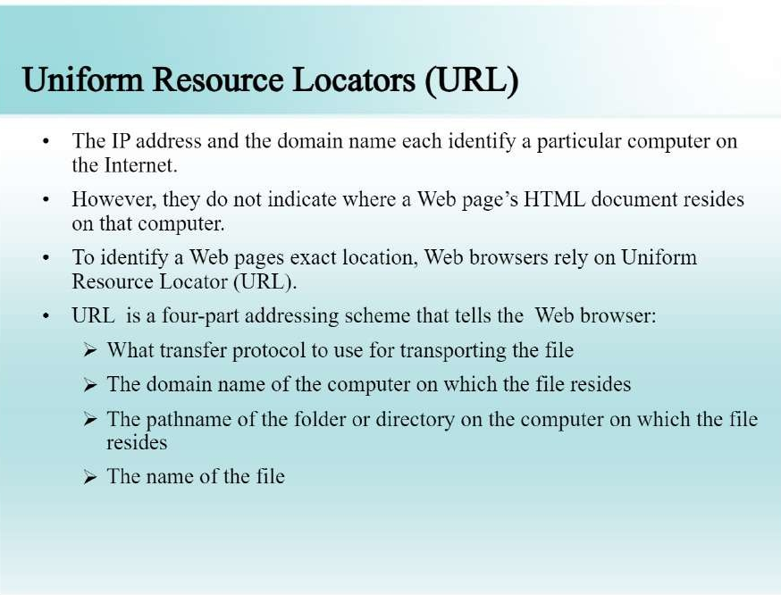

Slide 16
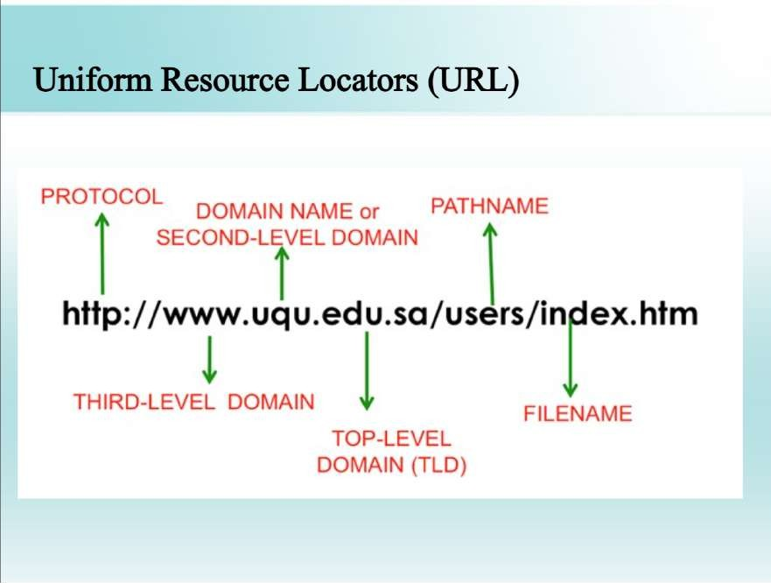

Slide 17
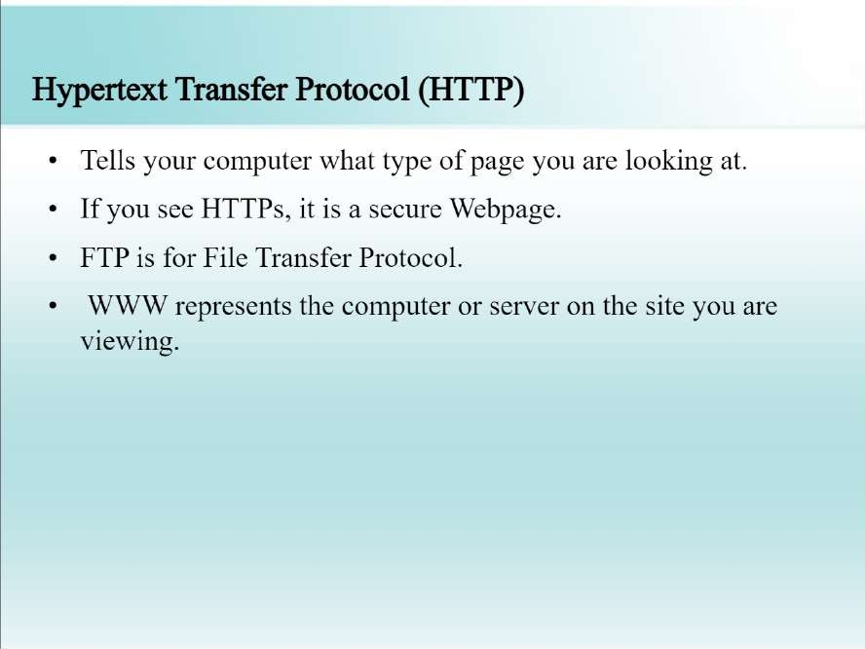

Slide 18
WWW
The World Wide Web, commonly known as the Web, is a system of interlinked hypertext/hypermedia documents accessed via the Internet.
Hypertext is text displayed on a computer or other electronic device with references to other text that the reader can immediately access, usually by a mouse click or key press sequence.
Hypermedia is used as a logical extension of the term hypertext in which graphics, audio, video, plain text and hyperlinks intertwine to create a generally non- linear medium of information.
Creator: Timm Berners-Lee, 1989.

Slide 19

Tim Berners-Lee
Father of W W W.
Invented WWW while working at CERN, the European Particle Physics Laboratory

Slide 20
Difference b/w the Web and Internet
Internet = collection of networks that connect millions of businesses, government agencies, educational institutions, and individuals.
WWW = the means we use to access information over the internet
Different communication protocols
Special link (hyperlink) that enable users to jump from one place to another on the web.

Slide 21
Web Page
A web page is a document or resource of information that is suitable for the World Wide Web and can be accessed through a web browser and displayed on a monitor or mobile device.
This information is usually in HTML or XHTML format, and may provide navigation to other webpages via hypertext links.
It can contain text, graphics, audio, video and has built- in connection or links to other web documents.
A web page has a unique address called a Uniform Resource Locator (URL).

Slide 22
Web Browser
A software application for retrieving, presenting, and traversing information resources on the World Wide Web.
It allows to locate, view, and navigate the web.
It can have a Graphical User Interface, meaning they can display pictures (graphics) in addition to text and other forms of multimedia such as sound and video like Internet Explorer, Mozilla Firefox, Chrome and Opera, or can be text-based, like Lynx or Links.
First web browser was develop in 1991: Mosaic develop by Marc Andreessen.

Slide 23


Slide 24
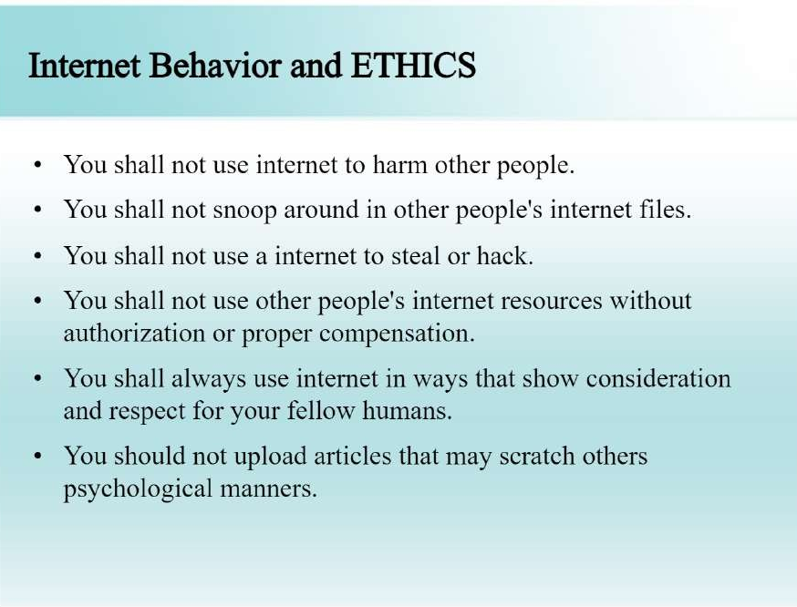

Slide 25
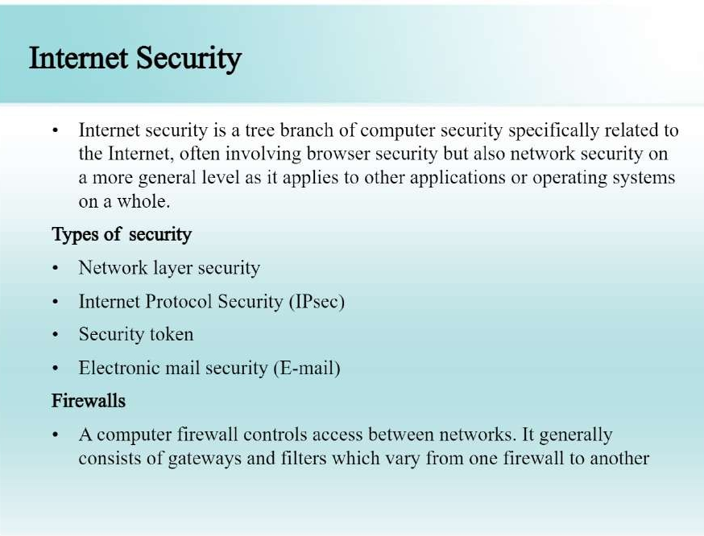

Slide 26
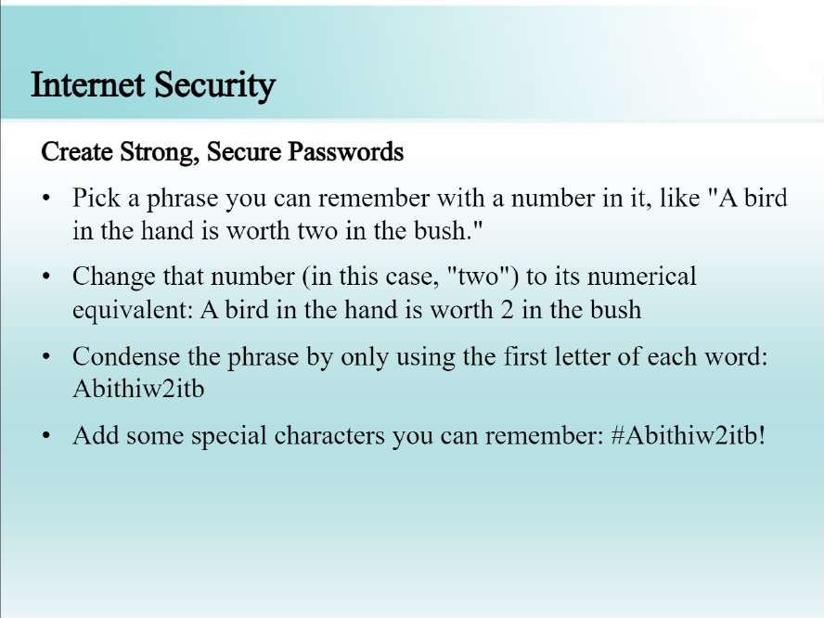

Slide 27
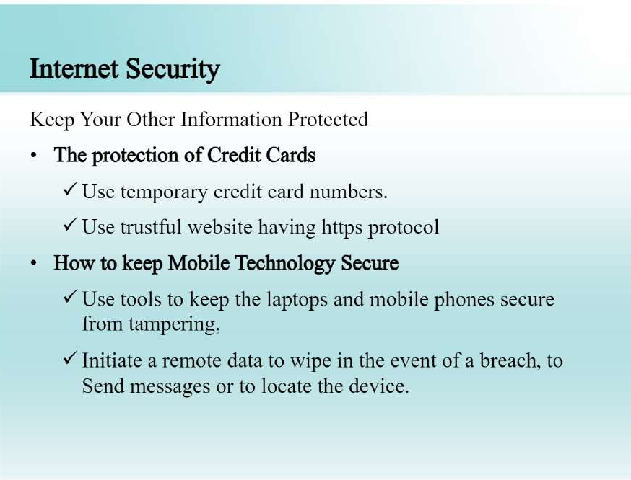

Slide 28
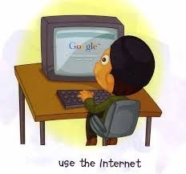
Advantages of Internet
Communication
Research
Education
Financial transactions
For Updates

Slide 29
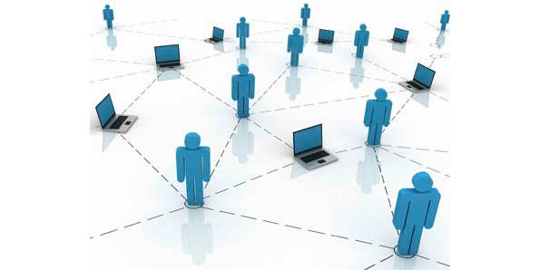
Advantages
Communication:
Communication is a process transmitting and receiving symbol, data, image, text, document, graphic etc by using various computer devices.
It including the process of collecting, processing, distributing, sharing, retrieving, transferring and storing the information
Internet now being a main communication tool. Using video conferencing, internet phone, Messenger, email etc.

Slide 30

Advantages
Research:
In order to do research you need to go through hundreds of books as well as the references and that was one of the most difficult jobs to do earlier.
Research is one such thing which has got lots of benefit from this evolution of internet.

Slide 31

Advantages
Education:
Education is one of the best things that the internet can provide
There are a number of books, reference books, online help centres, expert’s views and other study oriented material on the internet that can make the learning process very easier as well as a fun learning experience.

Slide 32

Advantages
Financial Transactions:
Financial transaction is the term which is used when there is exchange of money.
With the use of internet in the financial transaction, your work has become a lot easier.
With the ability to do the financial transaction easily over the internet you can purchase or sell items so easily

Slide 33


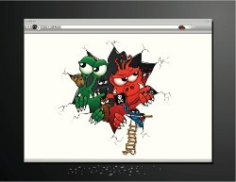

Disadvantages of Internet
Theft of Personal Information
Spamming
Malware Threats
Social Isolation, Obesity and Depression

Slide 34
Disadvantages
Theft of Personal Information:
The use of Internet for banking, social networking, or other services, often makes our personal information vulnerable to theft
Unscrupulous hackers can access our sensitive information through unsecured connections by planting phishing software.
•

Slide 35
Disadvantages
Spamming:
Spamming refers to sending unwanted e-mails, which serve no purpose and needlessly obstruct the computer system
Spammers usually use bots that bombard the receiver with an endless line of advertisements.
This can prove to be increasingly perplexing, as it keeps getting mixed with our more important emails
•
•

Slide 36
Disadvantages
Malware Threats :
One of the most annoying problems with the Internet is the ease with which any malware can infect our computers.
Virus programs are inconspicuous and may get activated simply by clicking a seemingly harmless link
Computers connected to the Internet are extremely prone to IP targeted virus attacks that may end up crashing the system completely.
•
•

Slide 37
Disadvantages
The biggest problem with having the Internet is, its ability to create rifts between the real and virtual world.
There is an addiction for everything that pertains to the web and that includes excessive surfing, online gambling, social networking, and gaming addiction
Since all problems are so deeply linked with one another and with the Internet, it isn't uncommon for people to be afflicted with multiple issues.
Social Isolation,Obesity and Depression:
•
•

Slide 38
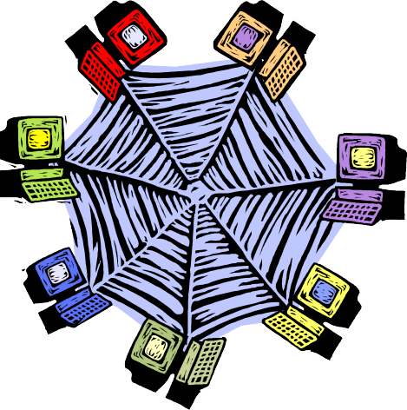
Client Server Architecture
A network architecture in which each computer or process on the network is either a client or a server.

Slide 39
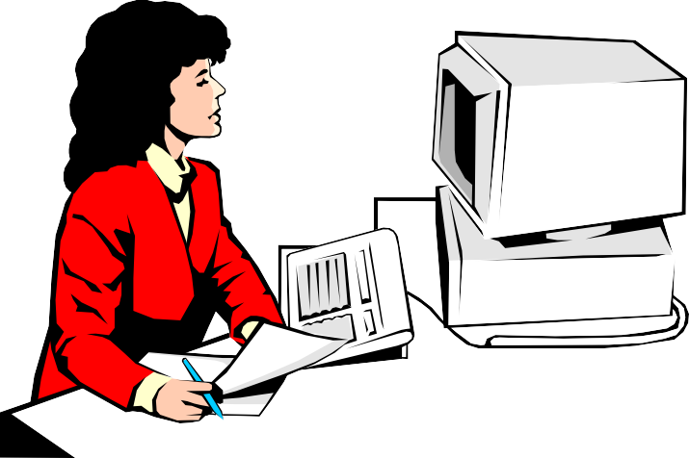
Components
Clients
Servers
Communication Networks
Server
Client

Slide 40
Clients
Applications that run on computers
Rely on servers for
Files
Devices
Processing power
Example: E-mail client
Clients are Applications
An application that enables you to send and receive e-mail

Slide 41
Servers
Computers or processes that manage network resources
Disk drives (file servers)
Printers (print servers)
Servers Manage Resources
Network traffic (network servers)
Example: Database Server
A computer system that processes database queries

Slide 42





Communication Networks
Networks Connect Clients and Servers

Slide 43
Client–Server Computing
Process takes place
on the server and
on the client
Servers
Store and protect data
Client-Server Computing Optimizes Computing Resources
Process requests from clients
Clients
Make requests
Format data on the desktop

Slide 44
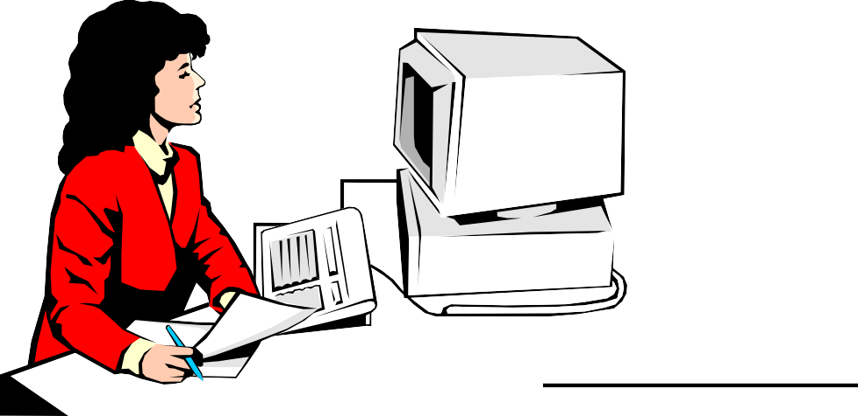
Application Functions
Software application functions are separated into three distinct parts
Server: Data Management
Client: Presentation & Application Logic

Slide 45
Application Components
3
2
1
Data Management
Application Logic
Presentation
2 Client Types
Fat Client
Thin Client
3 Logical Tiers
Database Applications:
Most common use of client-server architectures

Slide 46
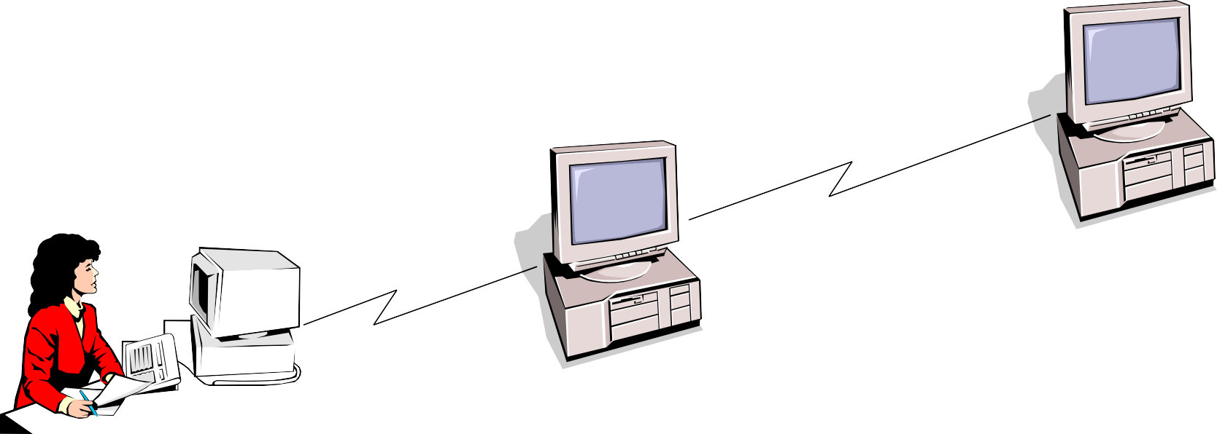
Middleware
Software that connects two otherwise separate applications
Example: Middleware product linking a database system to a web server
Database Server:
Manages Data
Middleware Links Applications
Web Server:
Presents Dynamic Pages
Client: Requests Data via Web

Slide 47
Types of Servers
From A to Z
Application Servers
Audio/Video Servers
Chat Servers
Fax Servers
FTP Servers
Groupware Servers
IRC Servers
List Servers
Mail Servers
News Servers
Proxy Servers
Telnet Servers
Web Servers
Z39.50 Servers
Source: http://webopedia.lycos.com

Slide 48
Advantages
Improved Data Sharing
Integration of Services
Shared Resources amongst Different Platforms
Inter-Operation of Data
Data Processing capability despite the location
Easy maintenance
Security

Slide 49
Disadvantages
Overloaded servers
Impact of centralized architecture

Slide 50
What is Internet?
is a Global network of computers which may be server or client that exchanges information.
It can be defined as a "network of networks" which can be linked through copper wires, wireless connections, and other technologies.
This is the world-wide network of computers accessible to anyone who knows their Internet Protocol (IP) address.

Slide 51
What is Intranet?
The term Intranet is derived from two words: ‘Intra’ which means within and
‘net’ which means group of interconnected computers.
is a private computer network that uses Internet protocols and network connectivity to securely share any part of an organization's information or operational systems with its employees.
In short, an intranet is private network,

Slide 52
How it is different from Internet?
The technologies used in Intranet and Internet may be same but the main difference between them is that the information shared in intranet can be access only by authorized persons especially members or employees of the organization or company where as in internet the information is shared world wide with any public user to explain in simple terms, intranet is private, within the organization while internet is public available for global access

Slide 53
Benefits of intranets
Workforce productivity:
Intranets can help users to locate and view information faster and use app. relevant to their roles and responsibilities. With the help of a web browser interface, users can access data held in any database the organization wants to make available, anytime and - subject to security provisions – from anywhere within the company workstations, increasing employees' ability to perform their jobs faster, more accurately, and with confidence that they have the right information. It also helps to improve the services provided to the users.
Time:

Slide 54
Communication:
Intranets can serve as powerful tools for communication within an organization, vertically and horizontally. From a communications standpoint, intranets are useful to communicate strategic initiatives that have a global reach throughout the organization.
The type of information that can easily be conveyed is the purpose of the initiative and what the initiative is aiming to achieve, who is driving the initiative, results achieved to date, and who to speak to for more information. By providing this information on the intranet, staff has the opportunity to keep up-to-date with the strategic focus of the organization.
Cost-effective:
Most organizations have already established TCP/IP networks, and the incremental infrastructure cost of adding Web servers to the network is well within even

Slide 55
Low maintenance
With information residing in only one place - the Web server - it is relatively easy and affordable to add new information or to update existing information and make it instantly available.

Slide 56
What is Extranet?
is an intranet for outside authorized users using same internet technologies. The outside users are trusted partners of the organization who have access to information of their interest & concern.
extends the intranet concept to provide a network that connects a company’s network to the networks of its business partners, selected customers, or suppliers.

Slide 57
An extranet is a web portal that is accessible by an organization and its external vendors, partners, customers, or any other users that require access to restricted information.
With an extranet, the host organization manages the site administration and content, and provides controlled access to internal and external members. Some example use cases for an extranet include a partner or vendor portal, a customer community, or a franchise network.

Slide 58
How it is different from Intranets?
Intranets differ from extranet in that the former are generally restricted to employees of the organization while extranets may also be accessed by customers, suppliers, or other approved parties. Extranets extend a private network onto the Internet with special provisions for access, authorization and authentication.

Slide 59
Types of Extranet
Public Network Extranet
exists when an organization allows the public to access its intranet from any public network. Security is an issue in this configuration, because a public network does not provide any security protection.
Private Network Extranet
Is a private, leased-line connection bet. Two companies that physically connects their intranets to one another. The single advantage of this is Security. The single largest drawback is Cost.
Virtual Private Network (VPN)
is a network that uses public networks and their protocols to send sensitive data to partners, customers,

Slide 60
